Slide 1
AFADL 2016
GenISIS: un outil de recherche d’attaques d’initié en
Systèmes d’Information
Authors: Amira RADHOUANI
Akram IDANI
Yves LEDRU
Narjes BEN RAJEB
Laboratoire d’Informatique de Grenoble

Slide 2
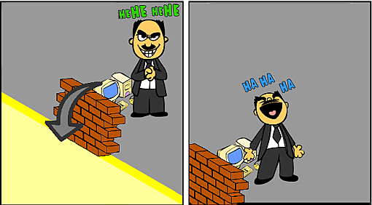
Context and motivation
Information System security includes =
Protection against external intruders
+
Insider attacks.
Great!!! thanks to my access, i’ll transfer all to my account
They are not smart enough these IT!

Slide 3
Outline
1. Introduction
Illustration example
Dynamic analysis
2. Malicious behavior
3. Extraction of malicious behaviors
Extraction of malicious behaviors from B Specification
Proof based approach
Constraint solving based approach
GenISIS tool
4. Conclusion

Slide 4
Introduction
Illustration example
Dynamic analysis
Notes:
2mn:15s

Slide 5
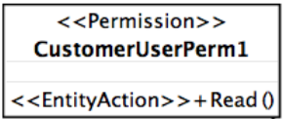
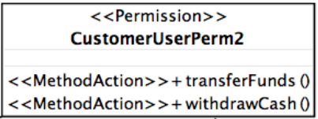
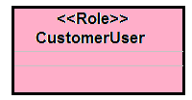
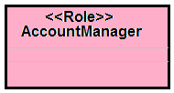
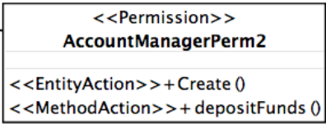
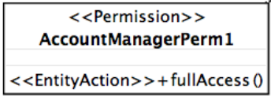
Illustration example
Notes:
La question qui se pose est ce qu’un conseiller financier peut faire un transfert d’argent d’un compte client.
Au vu des régles de CA, un conseiller financier n’a pas le droit d’accès à l’opération transferFunds. Donc une analyse statique qui a pour but de valider la sécurité du model à état donné nous confirmera qu’un conseiller financiuer ne pourrais pas transférer de l’argent à partir d’un compte client.

Slide 6
Dynamic Analysis
Dynamic analysis searches for sequences of actions modifying the state and breaking the authorization constraint.
cpt1
Paul
cpt2
cpt3
Bob

Slide 7
Malicious behavior
Notes:
2mn:15s

Slide 8
Malicious behavior
[A. Radhouani et al., Trans. Petri Nets and Other Models of Concurrency 10: 131-152 (2015)]
Notes:
Ce travail est publié je vous invite à lire la publication.
Donner un ordre de grandeur pour l’approche topnoc. Et une comparaison

Slide 9
Extraction of malicious behaviors
1. Extraction of malicious behaviors from B Specification
2. Proof based approach
3. Constraint solving based approach
4. GenISIS Tool
Notes:
2mn:15s

Slide 10
Extraction of malicious behaviors From B Specification
Symbolic transition system
Notes:
Based on model exploration of finite systems and be used to find a sequence of actions leading to a given state or property.

Slide 11
Extraction of malicious behaviors From B Specification
Symbolic proof
Proof obligations on reachability properties:
Having E and F, 2 disjoint state predicates
And op(x₁,x₂,...,x_{n}) is an operation of the IS.
Enabledness:
Reachability:
E
F
Notes:
STS = symbolic transition system.

Slide 12
Extraction of malicious behaviors From B Specification
o_{i}
op_{m}

Slide 13
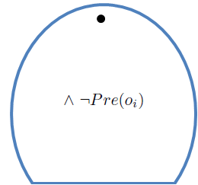
Extraction of malicious behaviors From B Specification
o_{i}
op_{m}
Notes:
STS = symbolic transition system.

Slide 14
Extraction of malicious behaviors From B Specification
o_{i-1}
o_{i}
op_{m}
Notes:
STS = symbolic transition system.

Slide 15
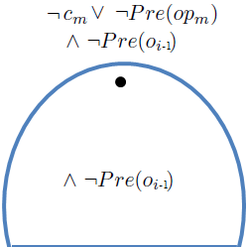
Extraction of malicious behaviors From B Specification
o_{i-1}
o_{i}
op_{m}
Notes:
STS = symbolic transition system.

Slide 16
Extraction of malicious behaviors From B Specification
o_{i-2}
o_{i-1}
o_{i}
op_{m}
Notes:
STS = symbolic transition system.

Slide 17
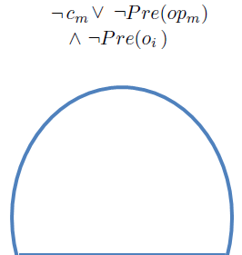
Extraction of malicious behaviors From B Specification
o_{i-2}
o_{i-1}
o_{i}
op_{m}
Notes:
STS = symbolic transition system.

Slide 18
Proof based approach
[A. Radhouani, A. Idani, Y. Ledru and N. Ben Rajeb. TopNoc10: 131-152 (2015)]
First step: Use of a prover (AtelierB) to extract symbolic operations.
Second step: Use a model-checker (ProB) to find operation valuations after eliminating operations which don’t appear in the first step.
AtelierB fails to discharge automatically PO when the proof becomes huge.
In our example:
First iteration: 3 extra operations are kept.
Second iteration: automatic proof fails for all operations.
Unable to extract scenarios that involve the same operation several times.
Notes:
STS = symbolic transition system.

Slide 19
Constraint solving based approach
Constraint solving problem:
Allows to valuate operation parameters.
Simplifies the proof.
Allows to extract scenarios which involves the same operation several times (the same operation with different valuations).
19
Notes:
STS = symbolic transition system.

Slide 20
GenISIS Tool
-Generator of Insider Scenarios from an Information System-
In
GenISIS Process
Out
JBtools
BoB
api
Constraint
solving
problems
CCL
Constraint solver

Slide 21
Conclusion
Notes:
2mn:15s

Slide 22
Conclusions
GenISIS was able to extract 9 scenarios.
2 real attacks: allowed in the security model.
7 fake attacks: not allowed in the security model.
A model-checker (i.e ProB) extracted the same attacks after exploring more than 1500 states and 36000 transitions.
GenISIS was Was successfully tested on 5 case studies.
Try it, it is available on open source in:
http://genisis.forge.imag.fr/

Slide 23
Thanks for your attention
23

Slide 24
secure IS Modeling
UML (class diagram) to model functional behavior.
SecureUML to model security rules (RBAC model).
Models translated into B in order to validate them separately.
Proof and model-checking techniques are used to validate both of them.
Functional Model
(e.g. Class diagram)
Security Model
(e.g. SecureUML)
Model transformation into B
Functional
Formal Model
Security
Formal Model
Proof
Tests
model-checking
V&V
V&V
Analyst
readMedicalRecord
SecReadMedicalRecord
joinHospital
SecJoinHospital
…
…
Analyst

Slide 25
Contextual constraints for permissions
Also called «authorization constraints» in SecureUML, or «programmatic access control».
Associated to permission rules.
Refer to elements of both models, then their validation must take both models into account!
For example :
The current user must be the owner of the object
➔ current user refers to the security model
➔ owner is an association defined in the functional model
➔ a change of ownership leads to changes in permissions
[Yves LEDRU, Overture Workshop, Aarhus, August 2013]

Slide 26
Conclusions
Advantages of the proposed approach:
Automated approach.
An alternative to the combinatorial explosion problem.
Was successfully tested on 5 case studies.
Takes into account the possibility of users collusion.
Disadvantages of the approach
Fails when operations have not precondition.
Explore the actions of the operations rather than their preconditions
Depends on the constraint solver performance: fails when the sets are infinite.
Combine the proof based approach and the constraint solving based approach

